Slide 1


Tips on Writing a Research Paper
Thomas Reps
University of Wisconsin

Slide 2
Rule #1
There is no universal rule for organizing your paper
However, there are some good guidelines out there
Simon Peyton-Jones, “How to write a great research paper”
Derek Dreyer, “How to write papers so that people can read them”
Simon Peyton-Jones, “Other resources”
Bear in mind that there will always be cases where it is best to deviate from any single proposed design

Slide 3

One Overarching Principle [SPJ]
The purpose of your paper is to convey your idea from your head to your reader’s head. All choices are made in support of this single goal
Explain it as if you were speaking to someone using a whiteboard
Conveying the intuition is primary, not secondary
Introduce the problem, and your idea, using examples and pictures
Once your reader has the intuition, she can follow the details (but not vice versa)
Present the general case later in the paper
Be relentless in working to achieve this goal
Everything you write should be in support of it
When you re-read and self-critique, your criterion is: “Does this material best support the goal of conveying my idea to the reader?”
Spoon-feed the reader

Slide 4
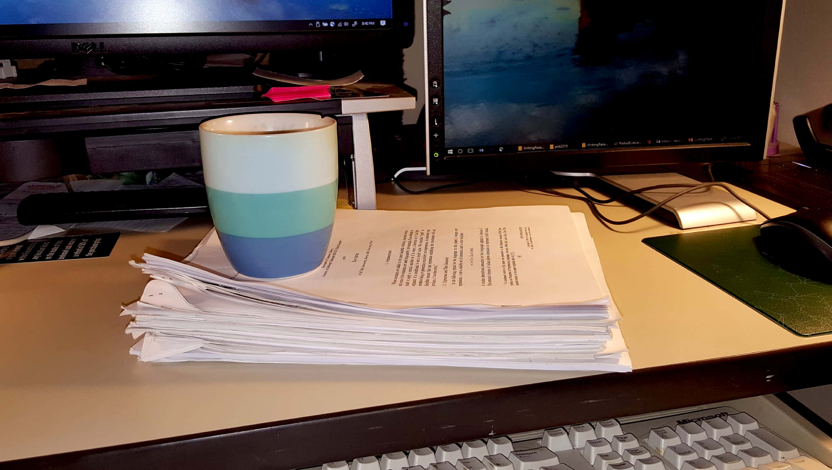
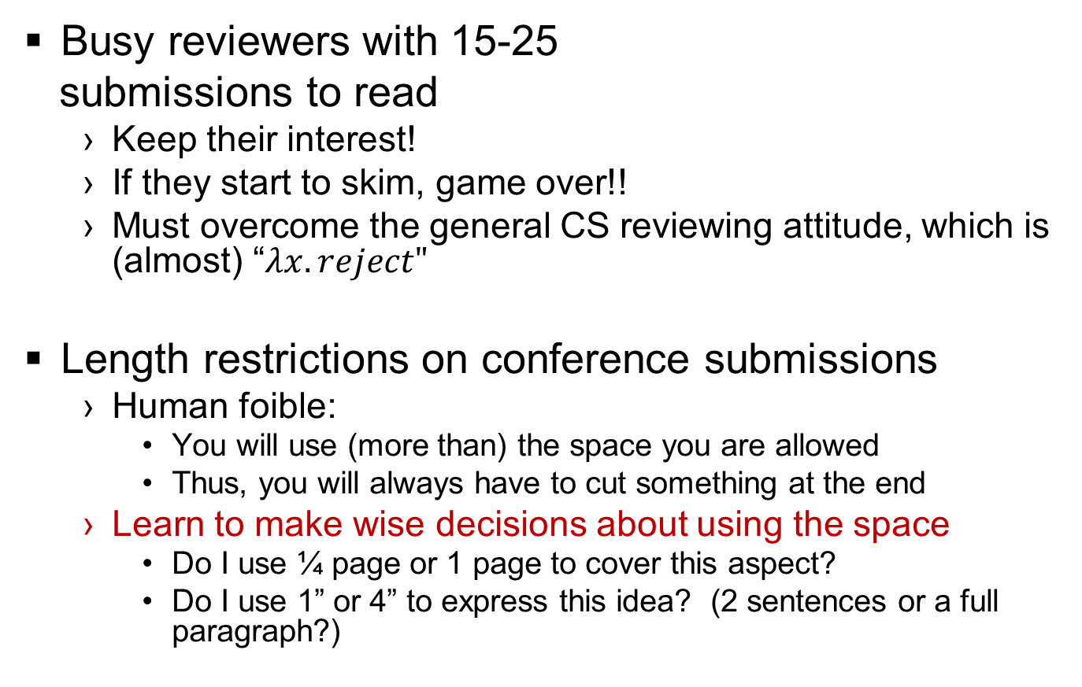
Two Overarching Challenges
Busy reviewers with 15-25
submissions to read
Keep their interest!
If they start to skim, game over!!
Must overcome the general CS reviewing attitude, which is (almost) “$λx.reject"$
Length restrictions on conference submissions
Human foible:
You will use (more than) the space you are allowed
Thus, you will always have to cut something at the end
Learn to make wise decisions about using the space
Do I use ¼ page or 1 page to cover this aspect?
Do I use 1” or 4” to express this idea? (2 sentences or a full paragraph?)

Slide 5
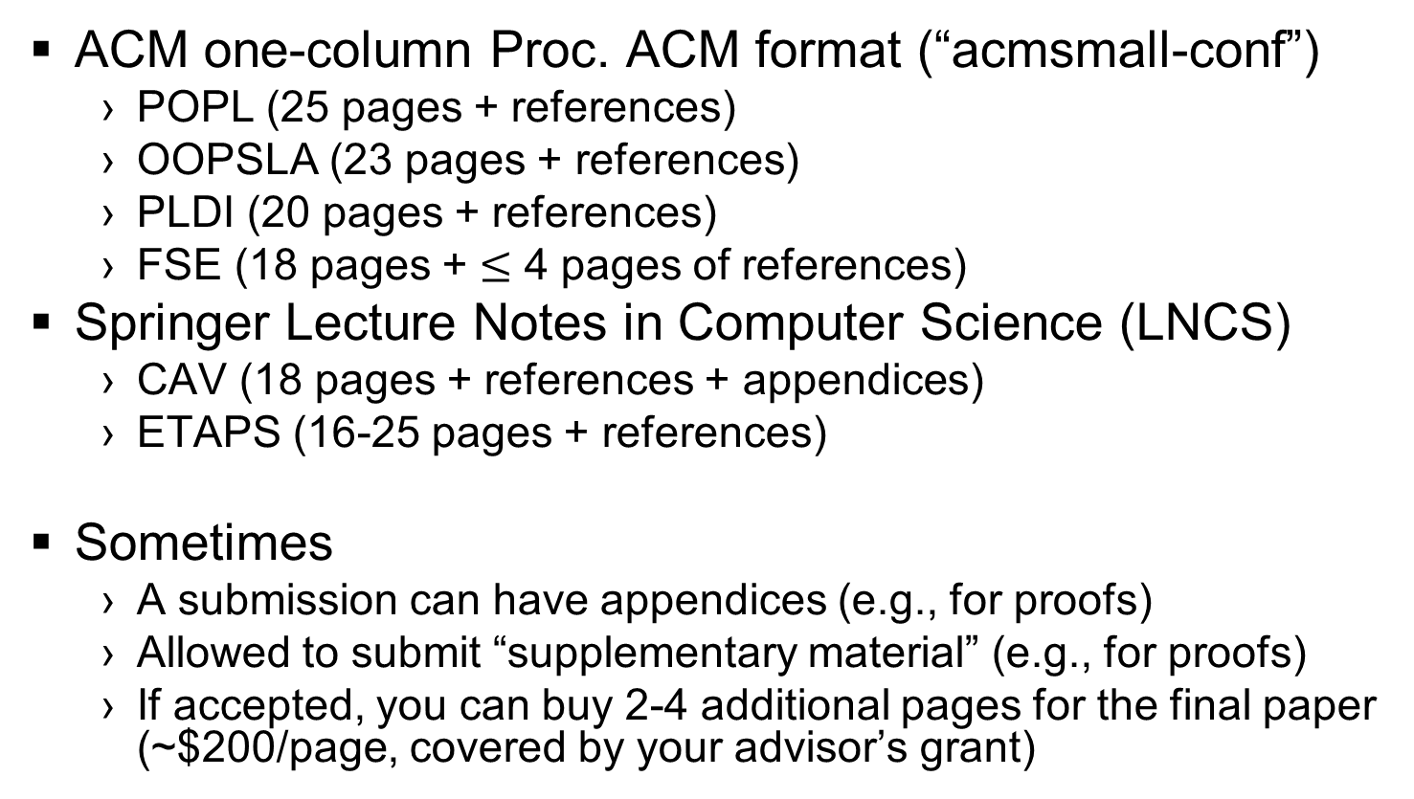
You will always be space constrained ☹
ACM one-column Proc. ACM format (“acmsmall-conf”)
POPL (25 pages + references)
OOPSLA (23 pages + references)
PLDI (20 pages + references)
FSE (18 pages + $≤$ 4 pages of references)
Springer Lecture Notes in Computer Science (LNCS)
CAV (18 pages + references + appendices)
ETAPS (16-25 pages + references)
Sometimes
A submission can have appendices (e.g., for proofs)
Allowed to submit “supplementary material” (e.g., for proofs)
If accepted, you can buy 2-4 additional pages for the final paper (~$200/page, covered by your advisor’s grant)

Slide 6
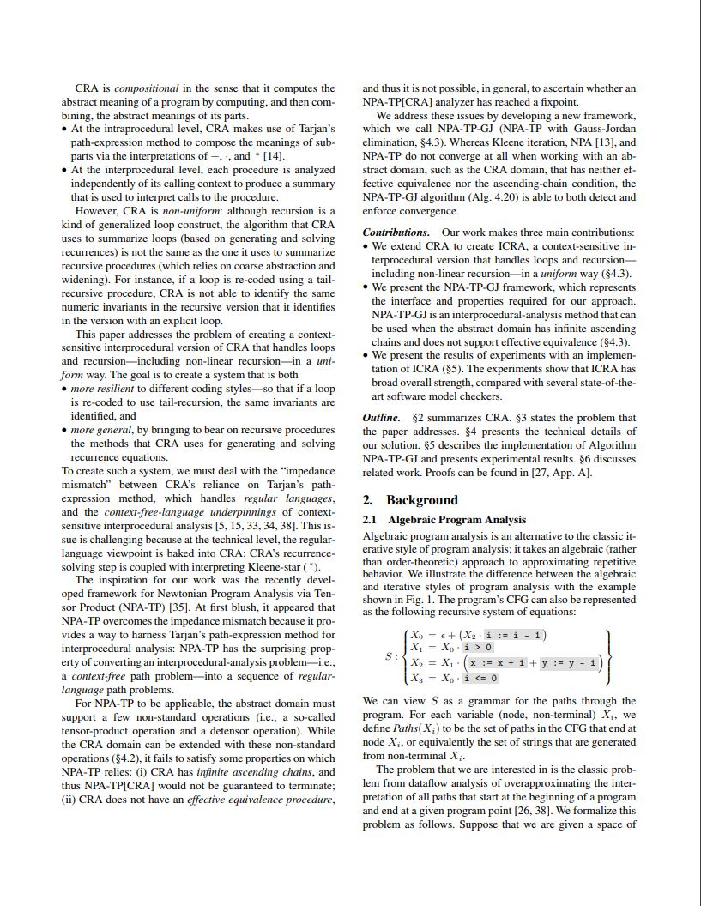
ACM two-column conference format
FSE (10 pages + references)
PLDI (12 pages + references)

Slide 7
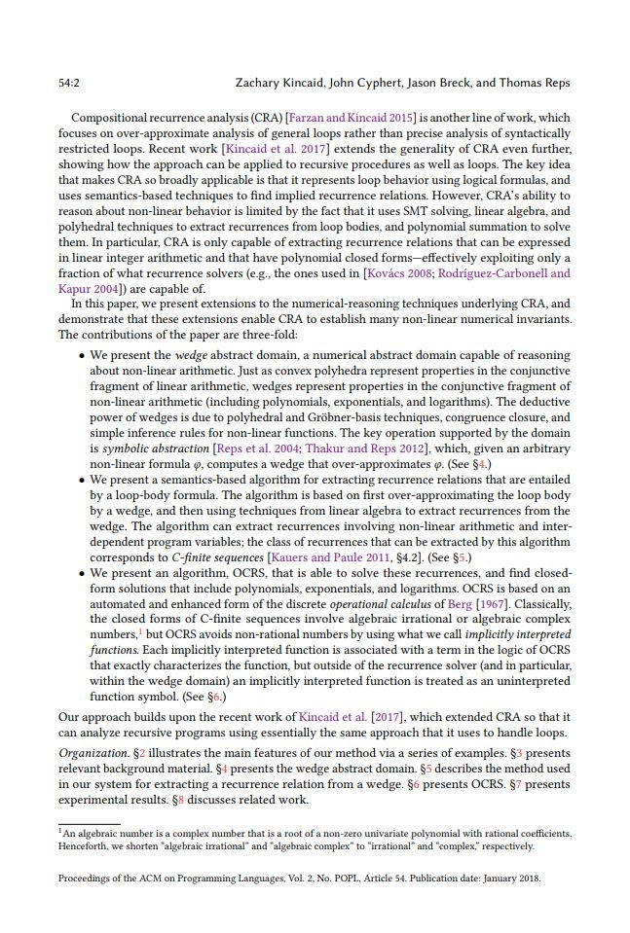
ACM one-column Proc. ACM format
POPL (25 pages + references)
OOPSLA (23 pages + references)
PLDI (20 pages + references)
FSE (18 pages + 4 pages of refs.)

Slide 8
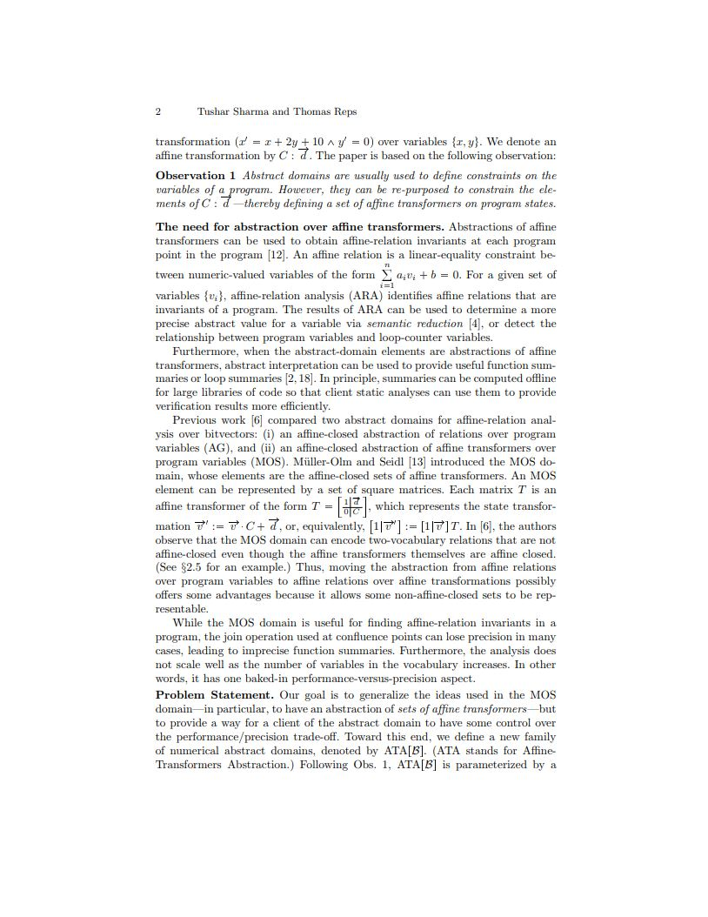
Springer LNCS
CAV (18 pages + references)
ETAPS (16-25 pages
+ references)

Slide 9
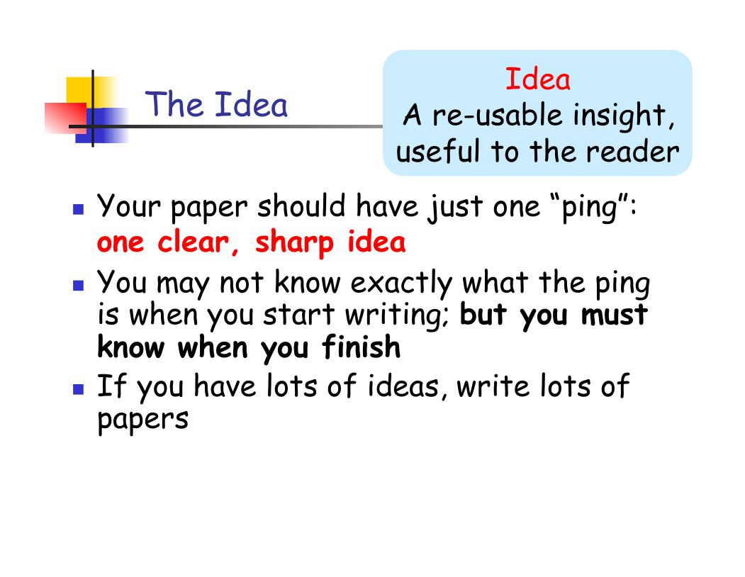
[SPJ]

Slide 10
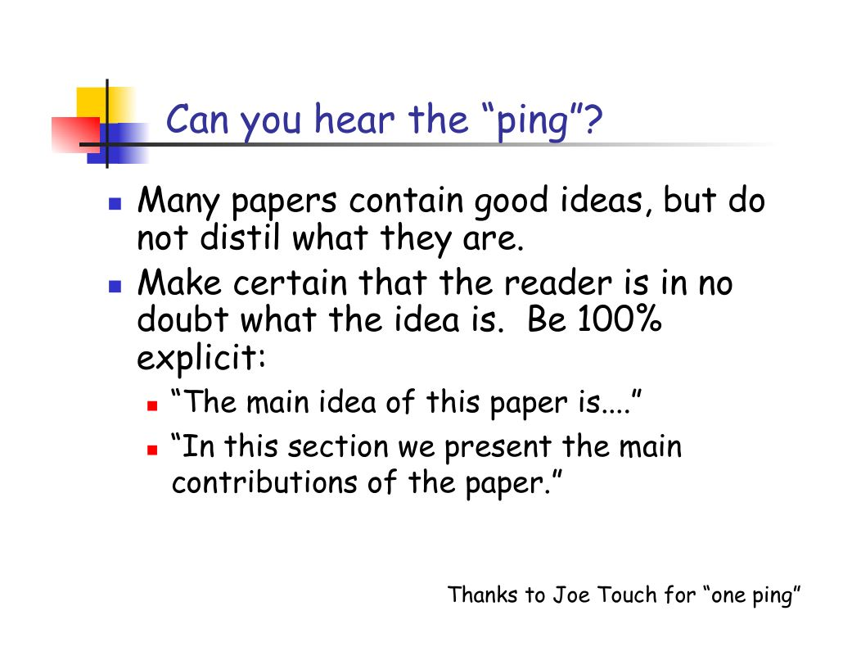
[SPJ]

Slide 11
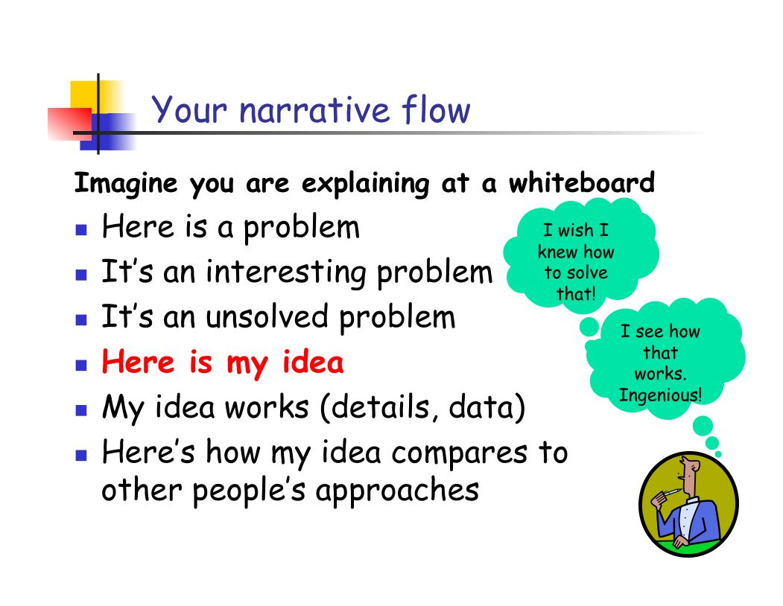
[SPJ]

Slide 12
Structure (conference paper) [SPJ]
Title (1000 readers)
Abstract (4 sentences, 100 readers)
Introduction (1 page, 100 readers)
The problem (1 page, 10 readers)
My idea (2 pages, 10 readers)
The details (5 pages, 3 readers)
Related work (1-2 pages, 10 readers)
Conclusions and further work (0.5 pages)

Slide 13
A structure that works [DD]
Abstract (1-2 paragraphs, 1000 readers)
Intro (1-2 pages, 100 readers)
Main ideas (2-3 pages, 50 readers)
Technical meat (4-6 pages, 5 readers)
Related work (1-2 pages, 100 readers)

Slide 14
A More Complete Structure [Reps]
Abstract
Introduction
Overview and Problem Statement
[Terminology and Notation]
Core Algorithm/Idea
[Extensions]
Experiments
[Limitations/Threats to Validity]
Related Work
[Conclusion]

Slide 15
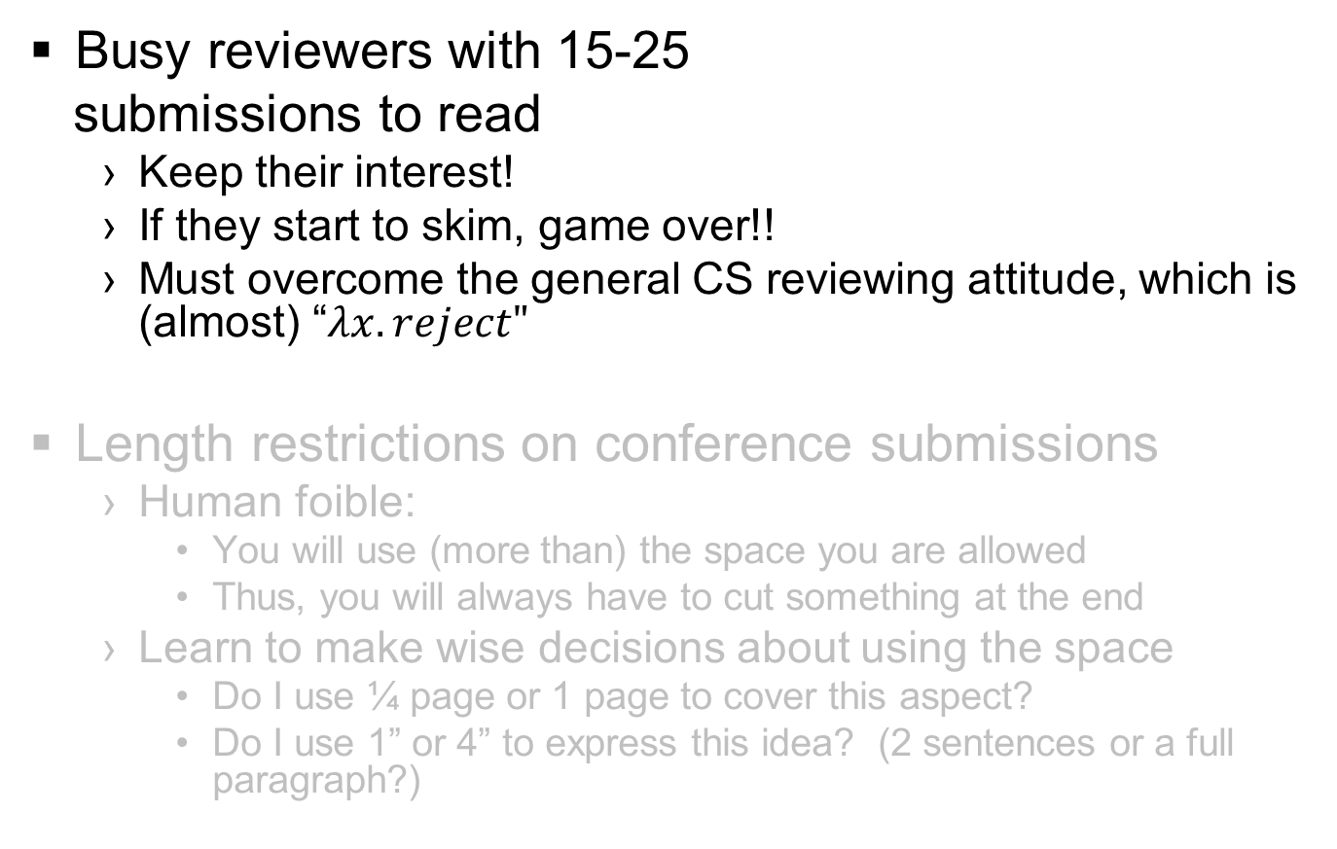
Two Overarching Challenges
Busy reviewers with 15-25
submissions to read
Keep their interest!
If they start to skim, game over!!
Must overcome the general CS reviewing attitude, which is (almost) “$λx.reject"$
Length restrictions on conference submissions
Human foible:
You will use (more than) the space you are allowed
Thus, you will always have to cut something at the end
Learn to make wise decisions about using the space
Do I use ¼ page or 1 page to cover this aspect?
Do I use 1” or 4” to express this idea? (2 sentences or a full paragraph?)

Slide 16
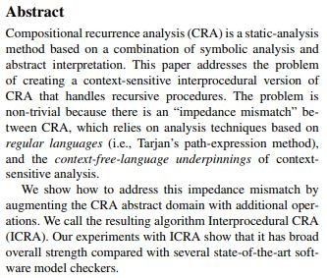
Abstract [Kent Beck via SPJ]
Four sentences
State the problem
Say why it’s an interesting problem
Say what your solution achieves
Say what follows from your solution

Slide 17
Introduction [SPJ]
Describe the problem
State your contributions
... and that is all
ONE PAGE!

Slide 18
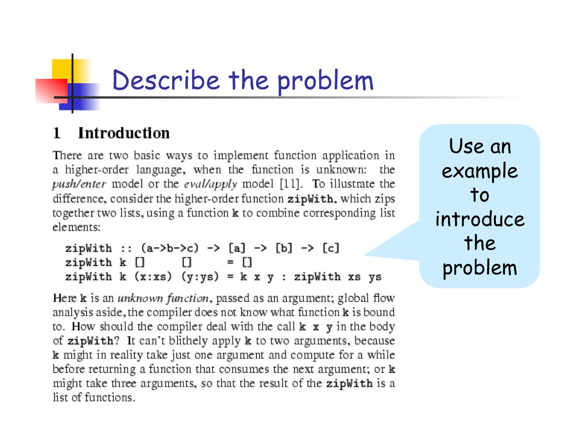
[SPJ]

Slide 19
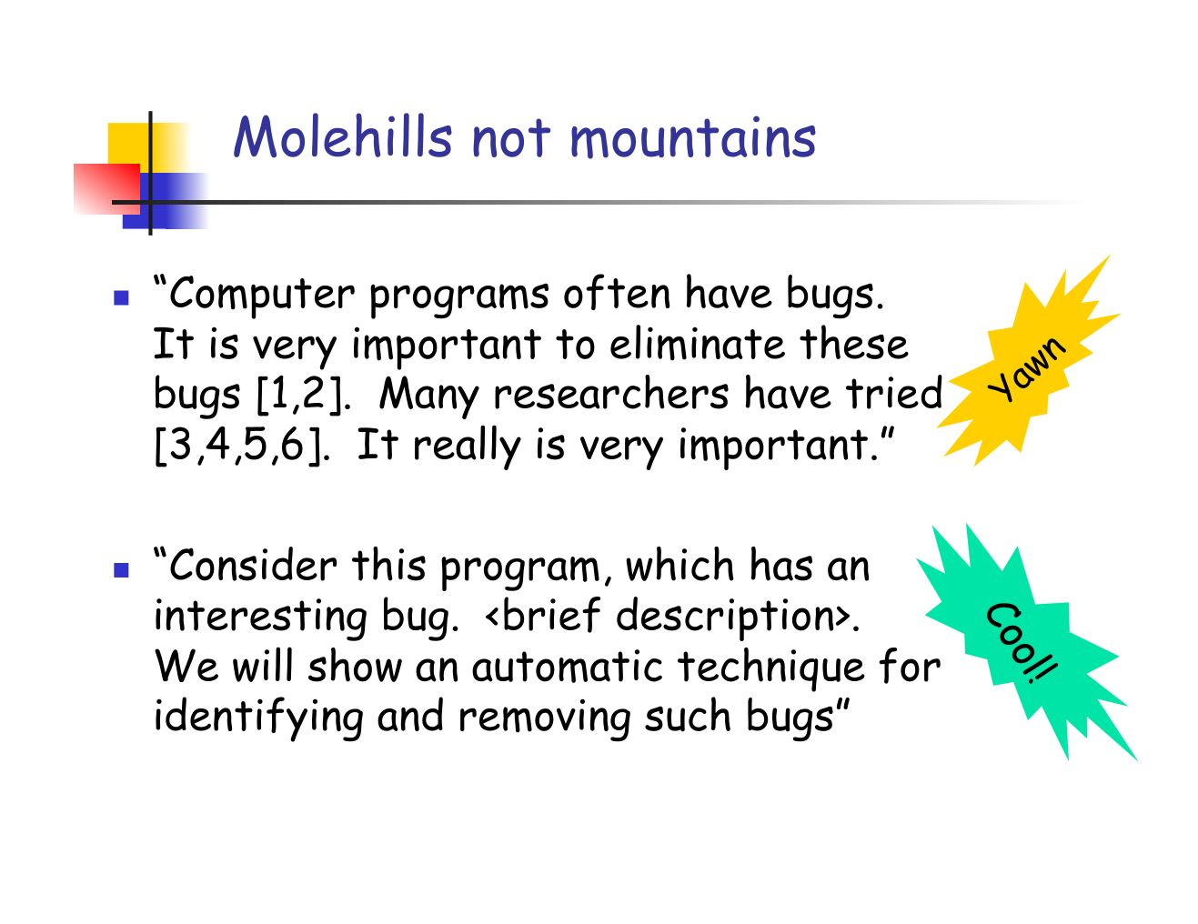
[SPJ]

Slide 20
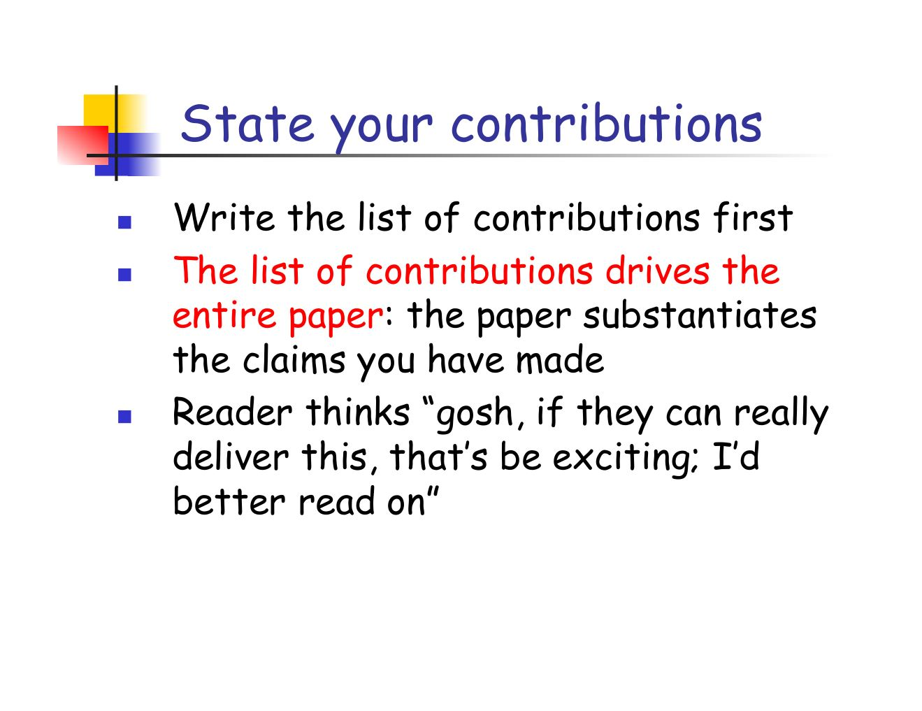
[SPJ]

Slide 21
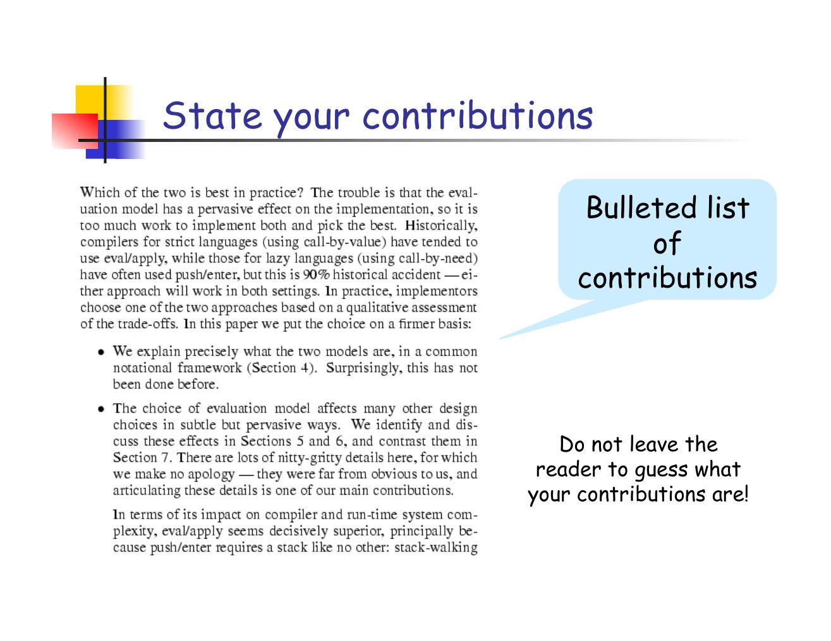
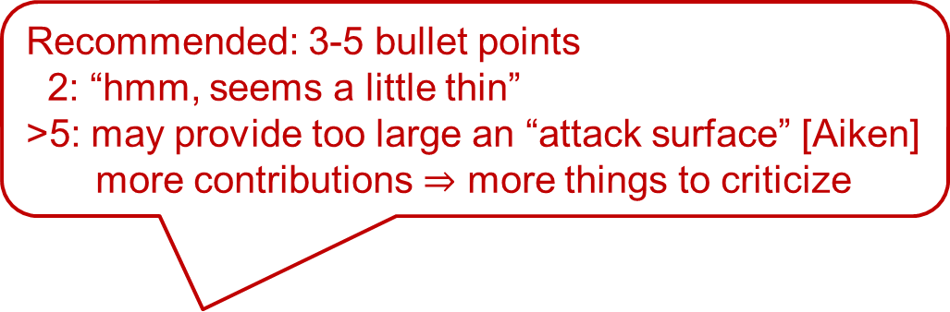
Recommended: 3-5 bullet points
2: “hmm, seems a little thin”
>5: may provide too large an “attack surface” [Aiken]
more contributions $⇒$ more things to criticize
[SPJ]

Slide 22
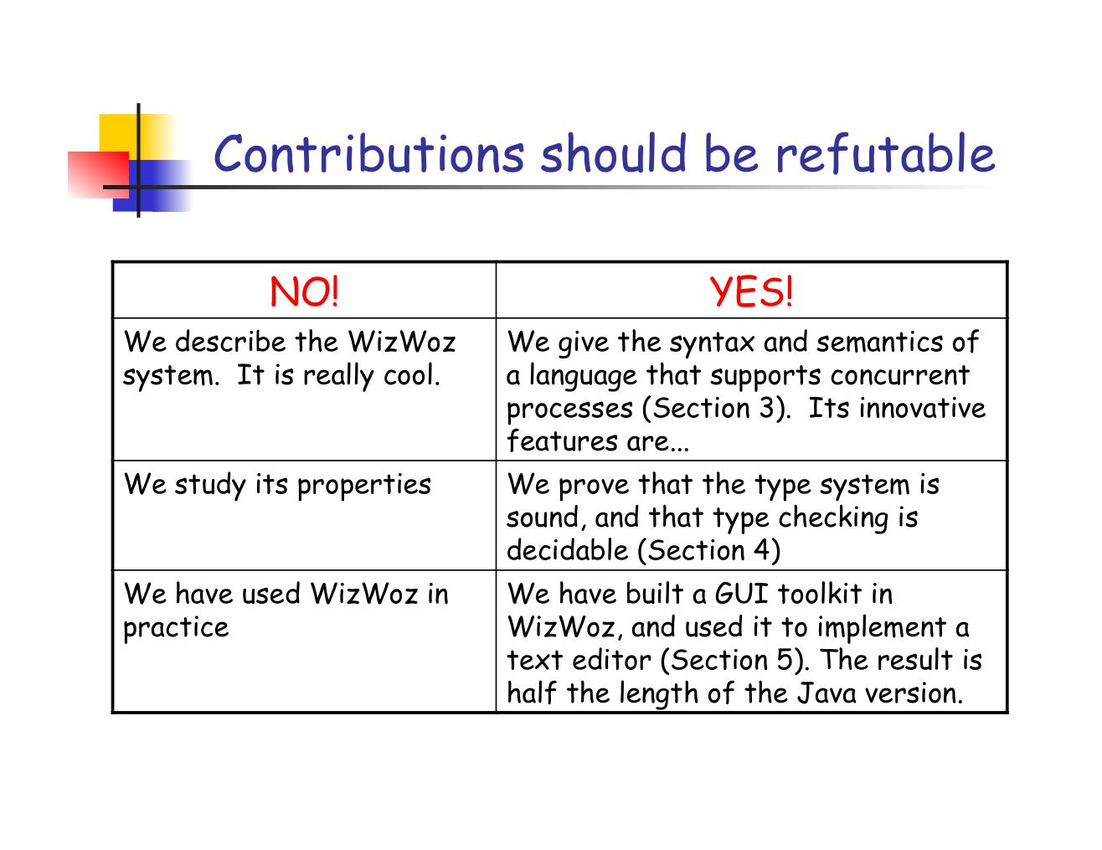
[SPJ]

Slide 23
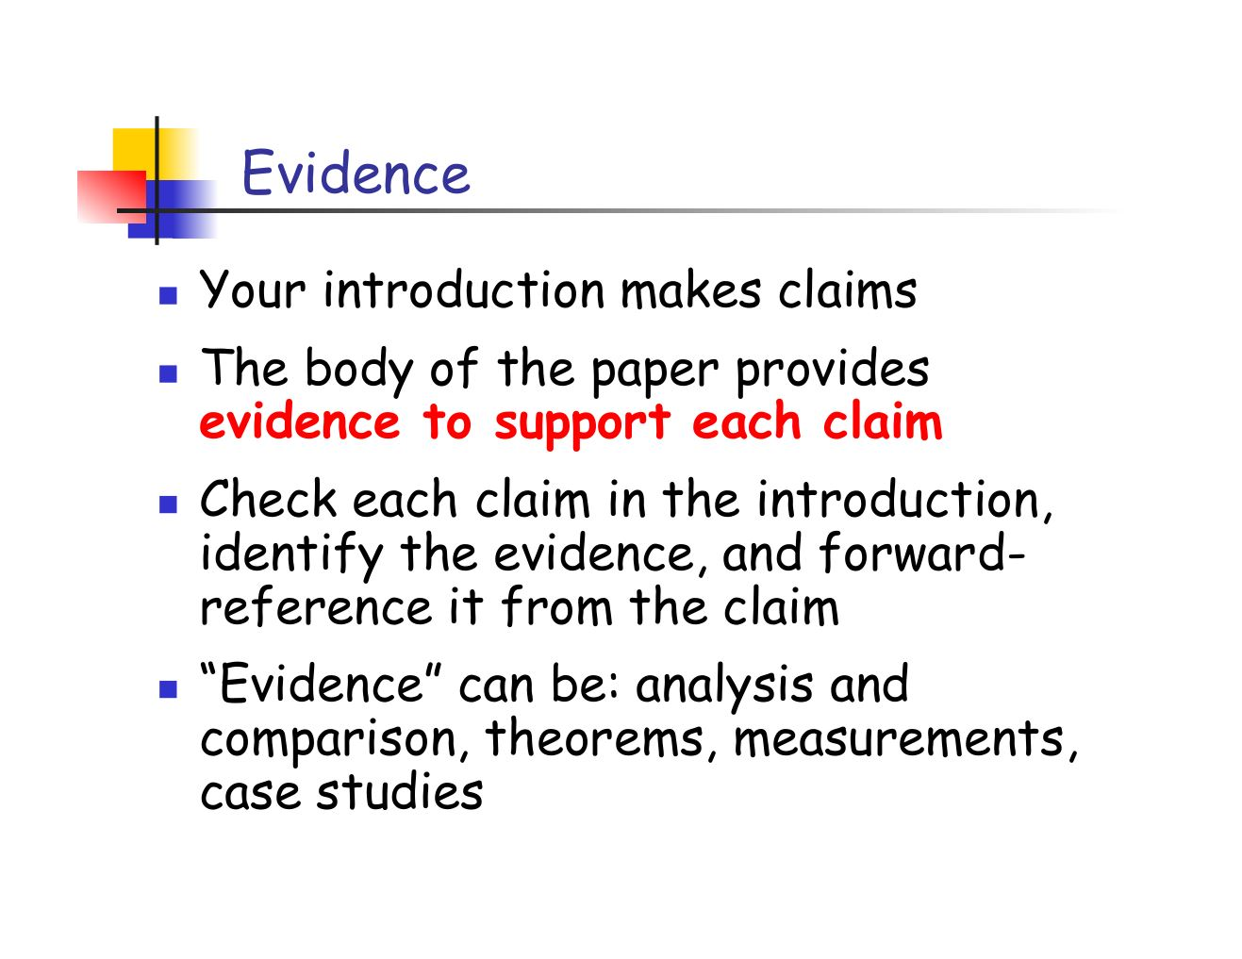
[SPJ]

Slide 24
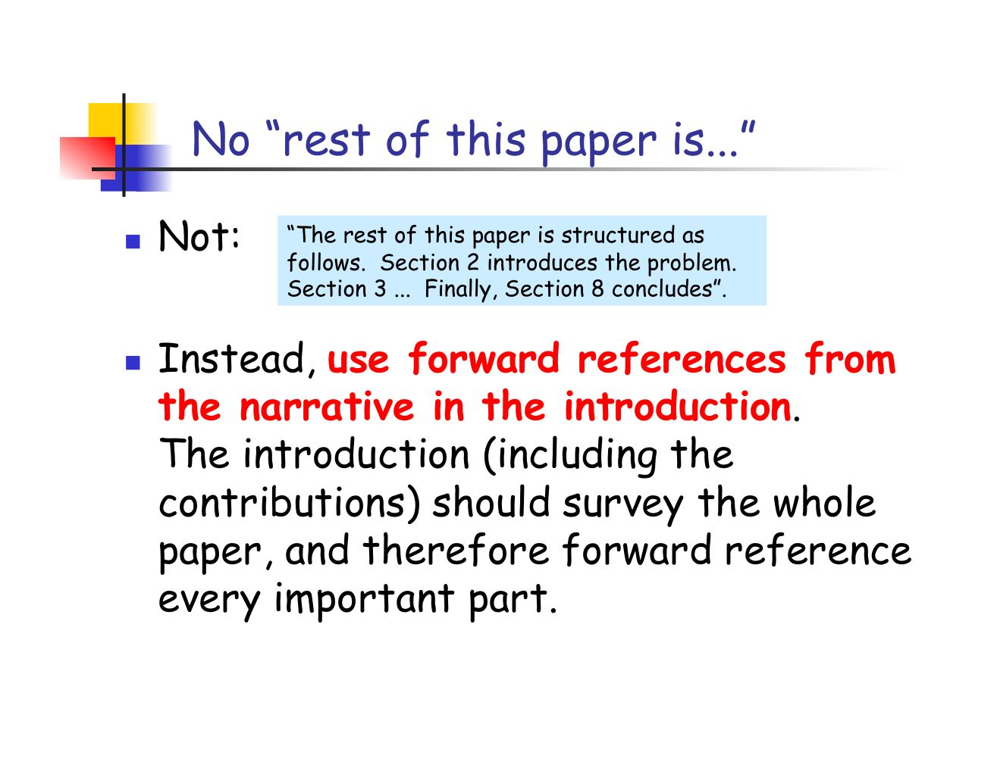
Well, maybe . . .
If you can do it, great!
Sometimes just too awkward, or not natural for the introduction to refer to some section(s)
I probably include such a paragraph more often than not
[SPJ]

Slide 25
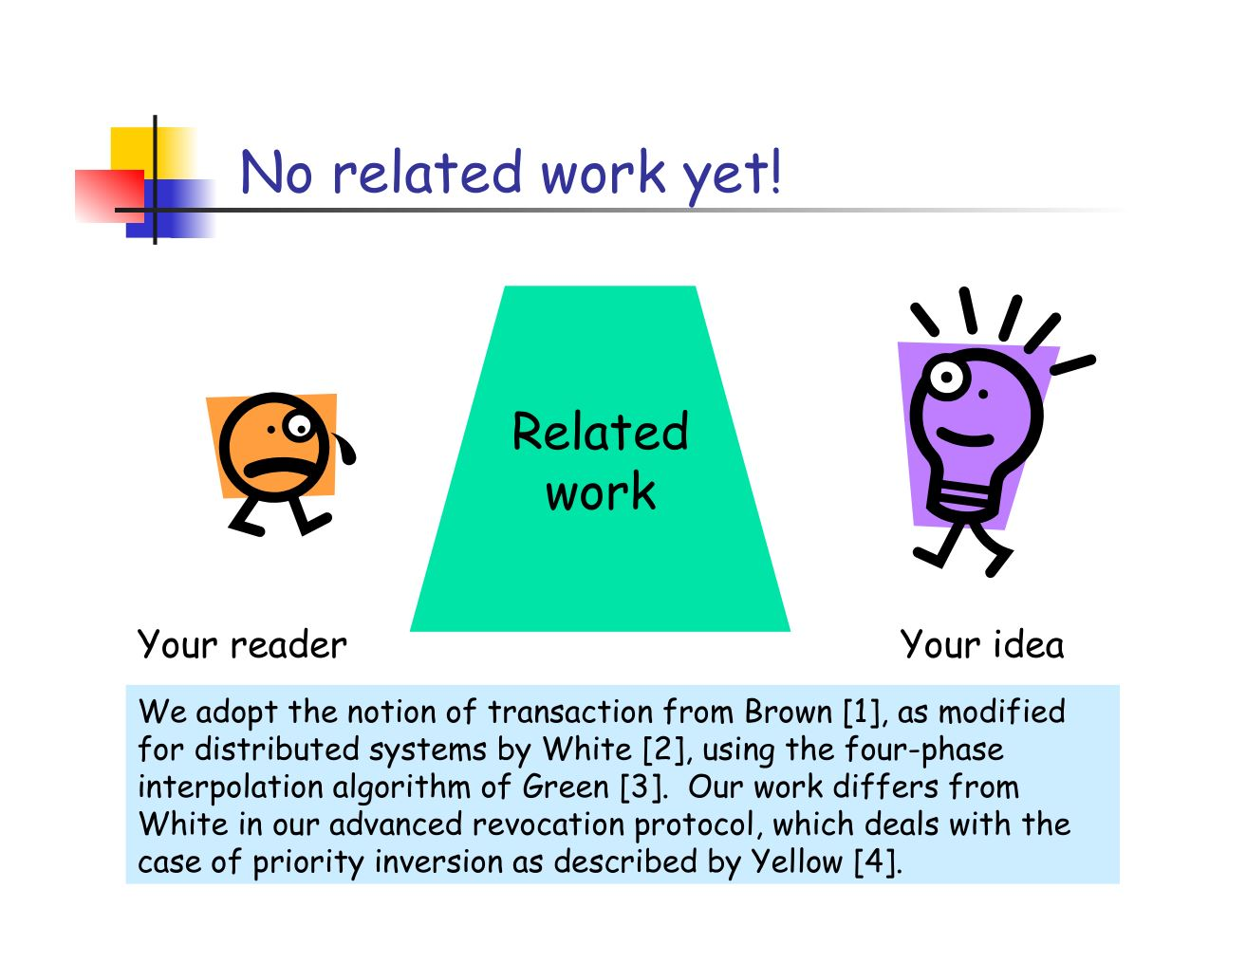
[SPJ]

Slide 26
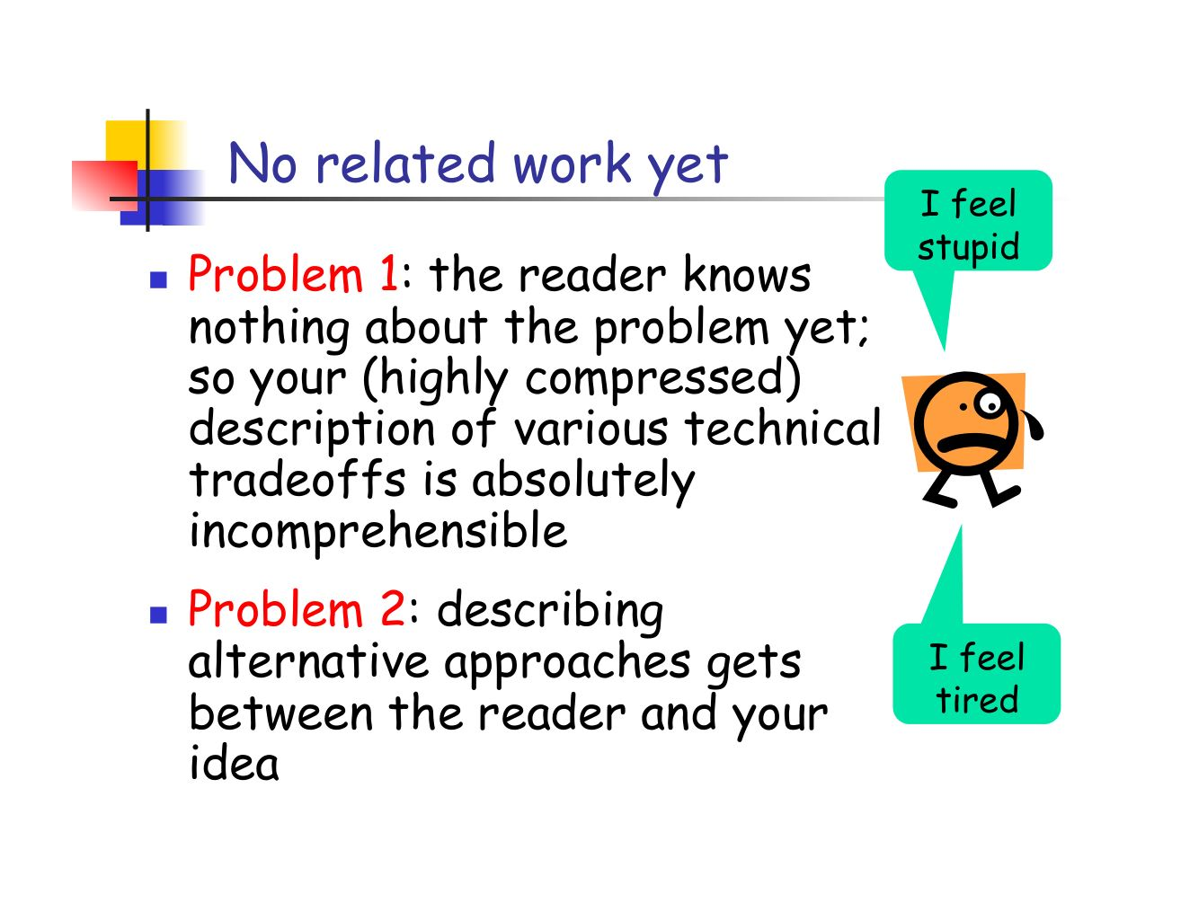
Often the no-related-work approach is the right one, but . . .
Sometimes it is better to discuss the 1-3 most important pieces of related work
The best way to introduce your idea might be to contrast it with some well-known concept
Sometimes you need to make sure that the reader understands some essential background on which your work depends
Want to ensure that the reviewer does not dismiss your idea as “It’s just the same as XXX.”
[SPJ]

Slide 27
DD critique of SPJ
SPJ’s approach to the Introduction eliminates context
Start with a concrete example, e.g. “Consider this Haskell code…”
If this works, it can be effective, but I find it often doesn’t work
It assumes reader already knows context

Slide 28
The CGI Model for an Abstract/Intro [DD]
Significance
Why is the work important?
Might be part of C, G, or I, or entirely separate
Context
Set the stage, motivate the general topic
Gap
Explain your specific problem and why existing work does not adequately solve it
Innovation
State what you’ve done that is new, and explain how it helps fill the gap
Introduction
An expanded version of the abstract, still using CGI

Slide 29
Abstract [Kent Beck via SPJ]
Four sentences
State the problem (C)
Say why it’s an interesting problem (G)
Say what your solution achieves (I)
Say what follows from your solution (S)

Slide 30
Introduction (Rev. Eng. from Zeldovich)
Elevator story -- high-level statement of the problem
The problem in more technical terms
Conventional wisdom: sketch of previous techniques and their shortcomings
Describe the solution to the problem as a black box, so that it is clear what your solution offers over previous work
Technical challenges to obtaining a solution (e.g., 1 paragraph for each)
State how you solve the challenges (at most a few paragraphs)
Experimental highlights
Contributions
Organization of the paper
C
G
I

Slide 31
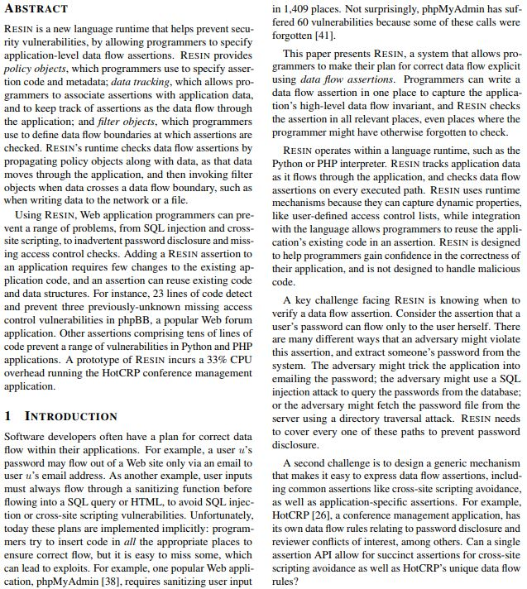
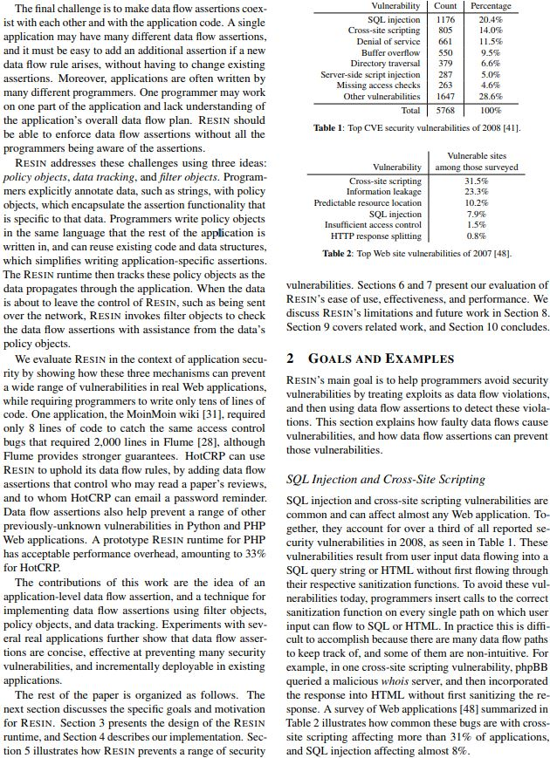
Zeldovich Example [SOSP09]
I: Solution
as black box
I: The solutions offered
C: The problem
I: Experimental
highlights
I: Challenges
Contributions
G: Conventional
wisdom
Organization

Slide 32
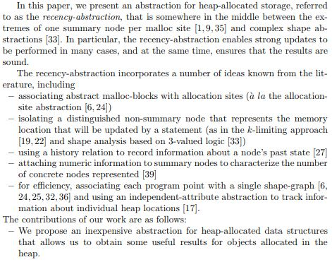
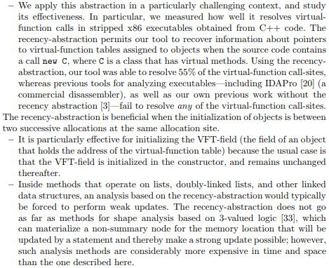
What If the Contribution is a Synthesis of Ideas?

Slide 33
A More Complete Structure [Reps]
Abstract
Introduction
Overview and Problem Statement
[Terminology and Notation]
Core Algorithm/Idea
[Extensions]
Experiments
[Limitations/Threats to Validity]
Related Work
[Conclusion]

Slide 34
Overview
SPJ:
Conveying the intuition is primary; do it using examples and pictures
Even if the reader skips the details, she still takes away something valuable
DD:
Forces you to have a “takeaway”
Many readers only care about the takeaway, not the technical details
For those who want the technical details, the intuition is still useful as “scaffolding”
The Gopan Principle:
“By the time the reader reaches the end of the Overview, they
should feel like they don’t need to read the rest of the paper.”
− Denis Gopan, c. 2006

Slide 35
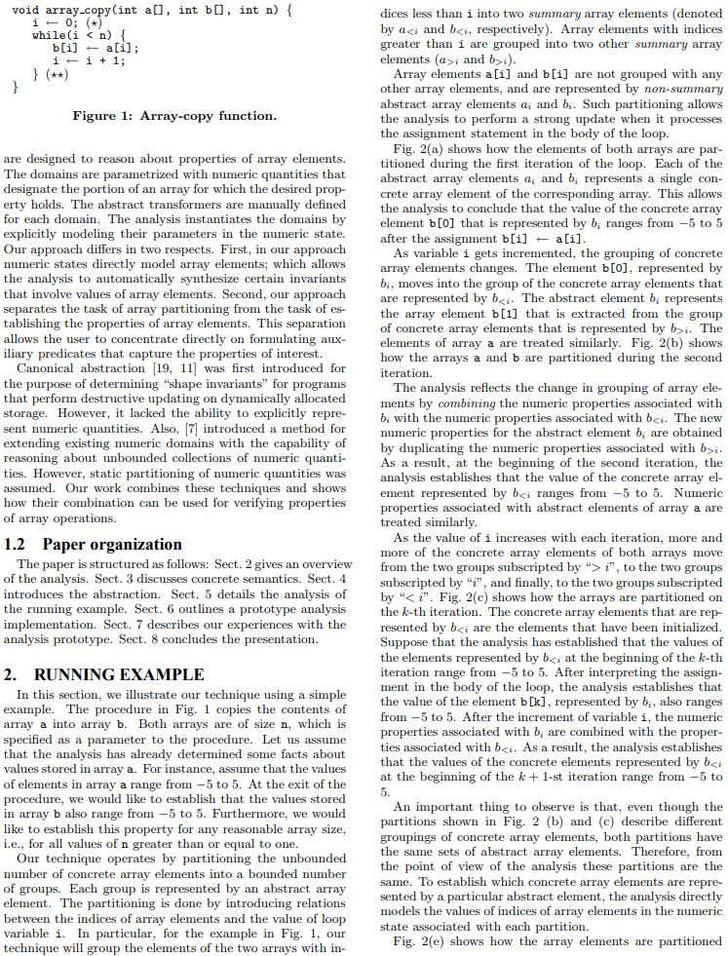
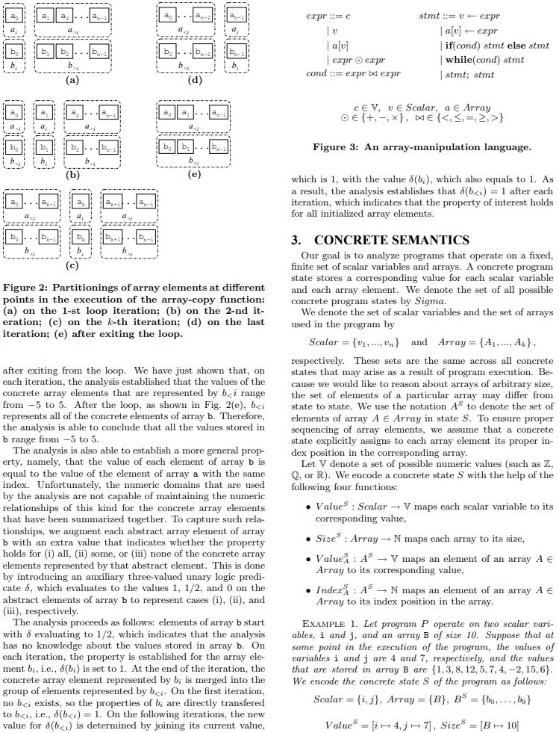
Gopan Example [POPL05]

Slide 36
Problem Statement
Somesh Jha: The problem statement is not
“The goal is to produce the kind of answers that my
algorithm produces”
The problem should be stated in a way that is independent of
any particular technique or method
Specify what is to be obtained, not how it is obtained
Declarative, not imperative

Slide 37
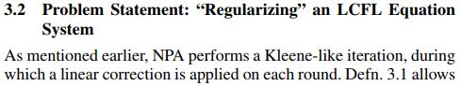
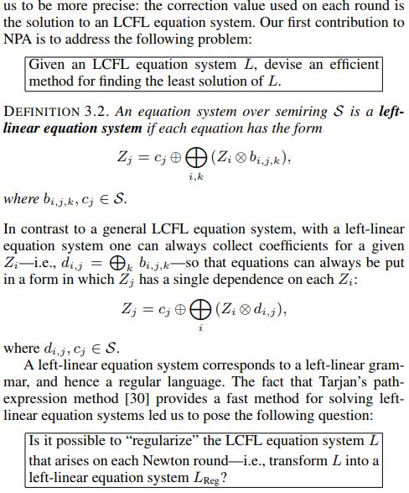
Problem Statement

Slide 38
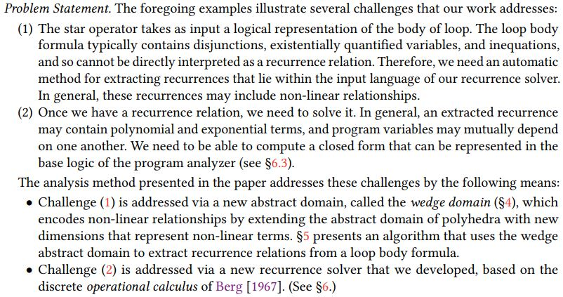
Problem Statement

Slide 39
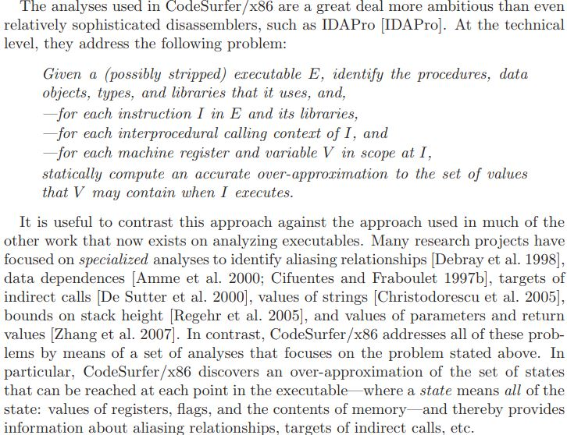
Problem Statement

Slide 40
A More Complete Structure [Reps]
Abstract
Introduction
Overview and Problem Statement
[Terminology and Notation]
Core Algorithm/Idea
[Extensions]
Experiments
[Limitations/Threats to Validity]
Related Work
[Conclusion]
The technical meat is often the easiest part to write
It is similar to the formalization that you find in a homework problem & solution
Gives a solution to the problem, including
Pseudo-code for algorithms
Theorems [and proofs or proof-sketches]

Slide 41
A More Complete Structure [Reps]
Abstract
Introduction
Overview and Problem Statement
[Terminology and Notation]
Core Algorithm/Idea
[Extensions]
Experiments
[Limitations/Threats to Validity]
Related Work
[Conclusion]

Slide 42
Experiments
Experimental questions
What hypothesis are you trying to test?
“The experiments were designed to answer the following
questions:
…
…
…”
Experimental setup
CPU, speed, amount of memory; OS version
Characteristics of the test suite
Experimental results
Table, graph, scatter-plot of X vs. Y, etc.
Don’t forget to say what the experiments showed about the experimental questions

Slide 43
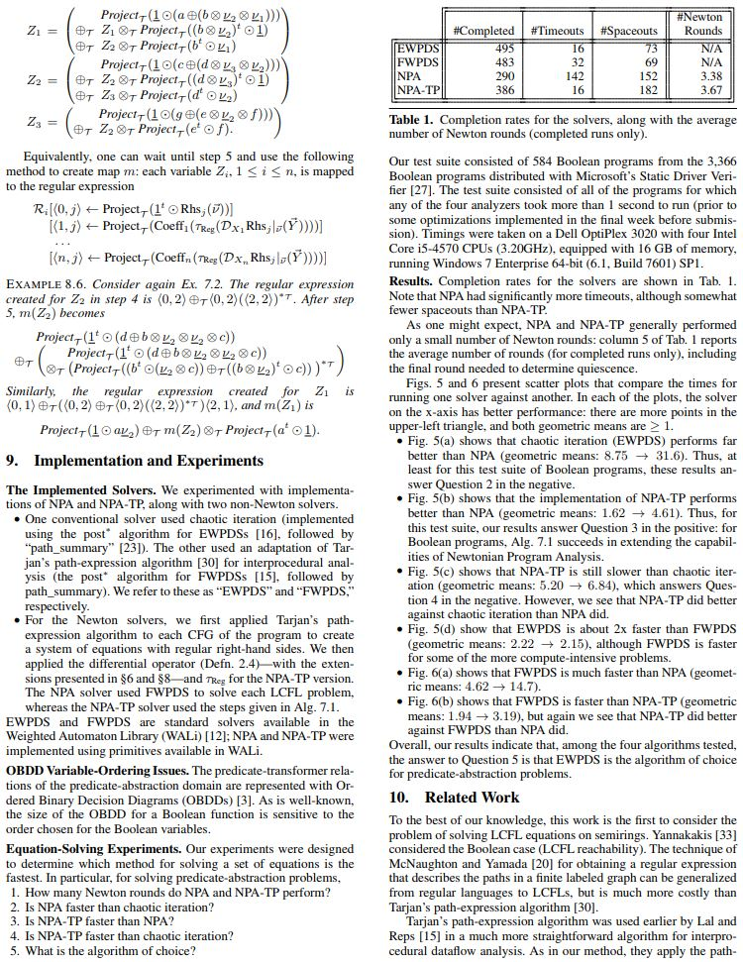
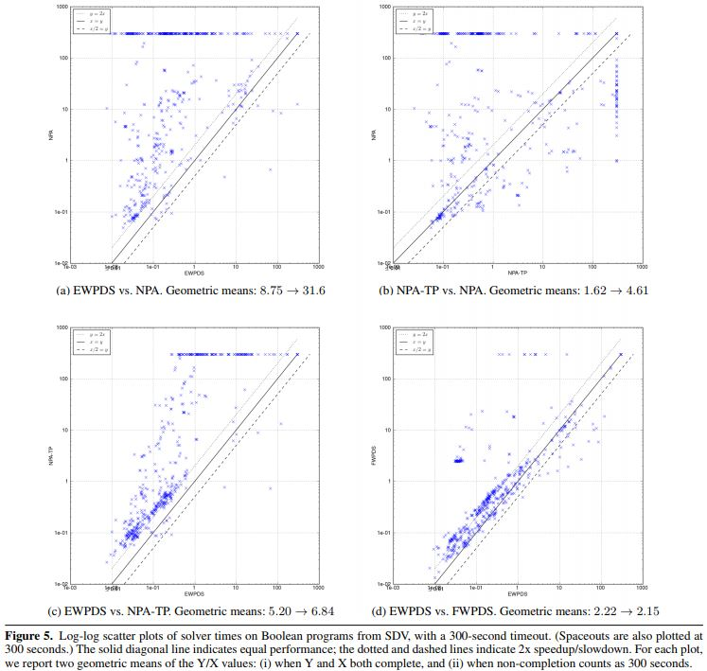
Experiments

Slide 44
Experiments
Our experiments showed that the answers to the questions were …
Our experiments were designed to answer the following questions:
…
…
…

Slide 45
Experiments: SIGPLAN Empirical Evaluation Checklist
“This checklist is organized into seven categories, each with associated examples for illustration. Categories are meant to be comprehensive, applying to the breadth of possible empirical evaluations. Examples in each category highlight specific, important areas in which best practice was frequently not followed. These are meant to be useful and illustrative, but they are neither comprehensive nor applicable to every evaluation.
The goal of the checklist is to help authors produce stronger scholarship, and to help reviewers evaluate such scholarship more consistently. Importantly, the checklist is meant to support informed judgment, not supplant it. The committee’s hope is that this checklist can put all members of the community literally on the same page.”
Webpage
PDF

Slide 46
Limitations/Threats to Validity [Software-Engineering papers]
Construct validity
Are the parameters studied in the experiments relevant to the research questions posed?
Internal validity
Is there selection bias in the examples chosen for study?
External validity
Do the conclusions hold in other scenarios
Ideally: explain how you addressed or controlled for these issues

Slide 47
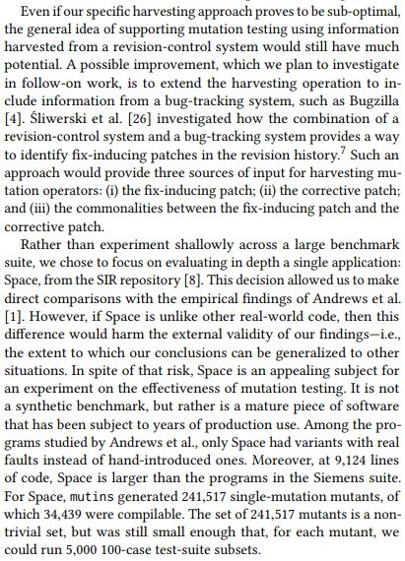
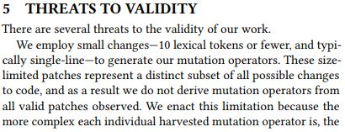
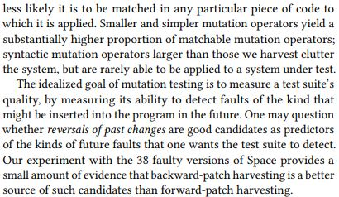
Example

Slide 48
Related Work
Don’t just list related papers
Honest comparison: what is the delta?
Be generous with credit
Complimentary + complementary

Slide 49
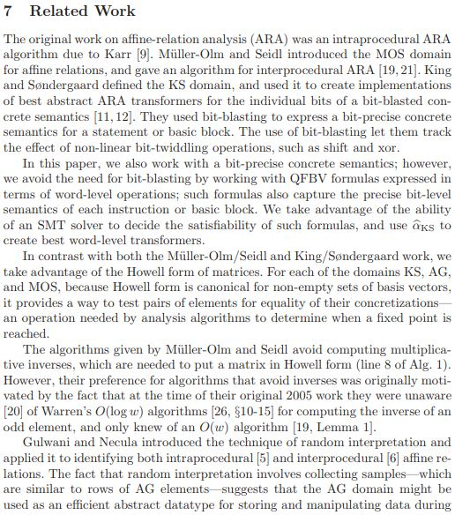
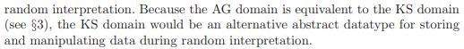
Related Work
Related
Comparison 1
Comparison 2
Comparison 3

Slide 50
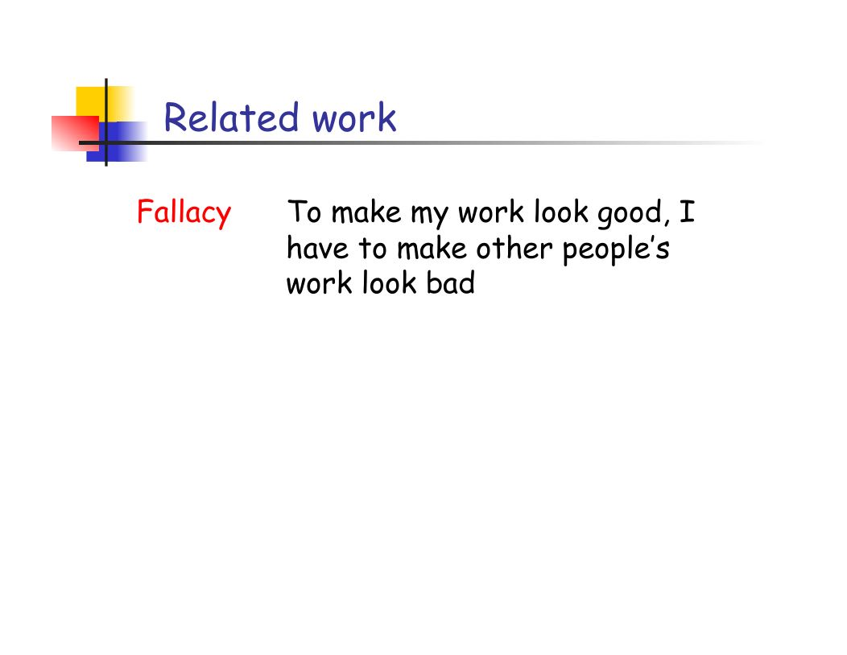
[SPJ]

Slide 51
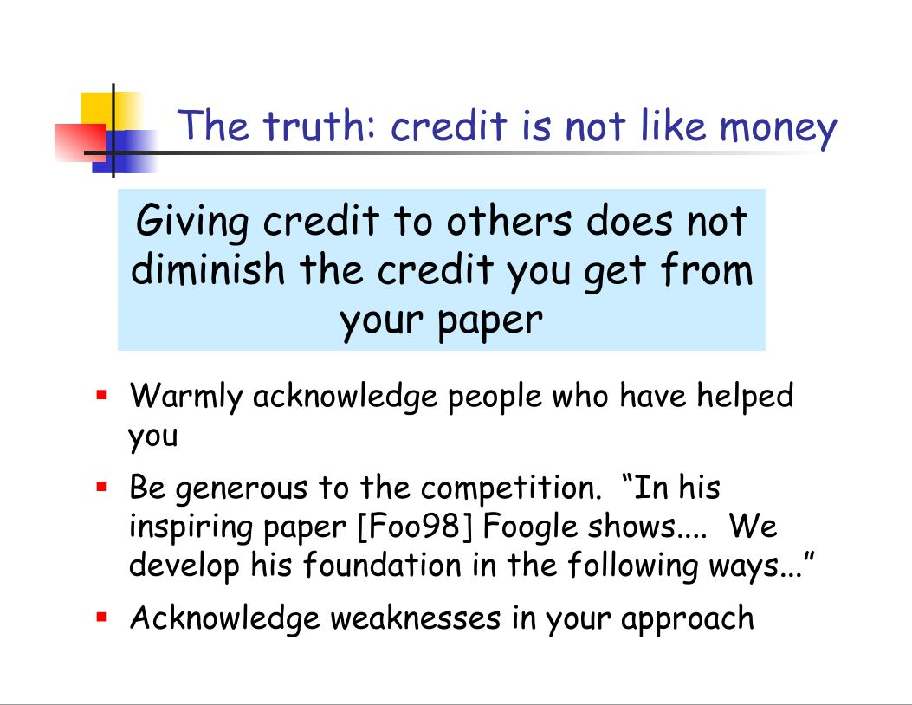
[SPJ]

Slide 52
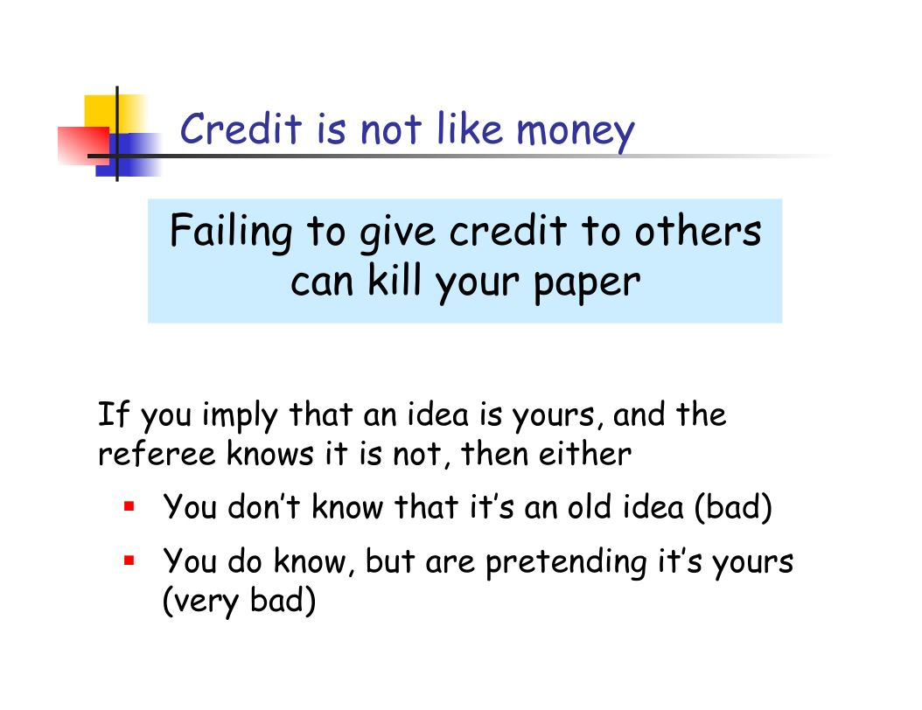
[SPJ]

Slide 53
Conclusion Section
Usually not needed (in my opinion)
First thing to be cut when I run out of space
But some reviewers complain
May be similar to the abstract, but can use the technical concepts introduced in the paper’s body
Allows you to reiterate what the experimental results showed
if your experiments are careful enough for you to claim them as definitive (rare)

Slide 54
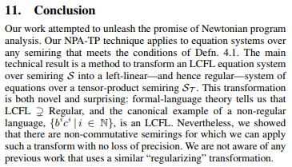
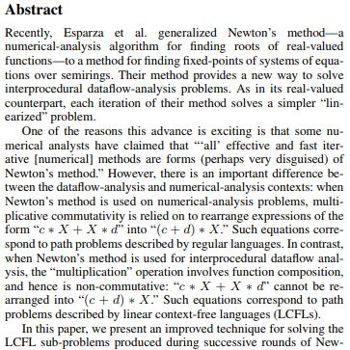
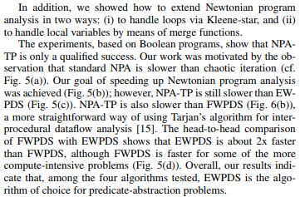
Conclusion Section
More technical recap of abstract
Recap of experiments

Slide 55
Write Some Items Early (but Revisit Frequently)
Settle on example figures, code, illustrative diagrams, etc. early
The Overview then “writes itself”: discuss/explain the elements of the example systematically
Abstract
Opinions vary
Do last
Do first, so you know what story you are trying to tell
A few key fragments
List of contributions (Introduction)
Running example (Overview)
Problem statement (Overview)
Research questions (Overview) & corresponding experimental questions (Experiments)
Choose the form in which you plan to display experimental results
Create mock-ups of the tables/figures
Technical meat
Pseudo-code for the key algorithms
Key examples
The remaining text “writes itself”: you just explain the algorithms and examples
As you write, your outlook typically changes
You might realize that YYY is really a contribution of your work
You may need to adjust the research questions, problem statement, etc.
…
The final paper should have no inconsistencies due to different parts being written when you had not-fully-formed views of the work
Avoid 11th-hour frustration: “Shoot, we never thought to implement the +A/-B configuration”
Feature B
 | No | Yes
No | ✓ | ✓
Yes | ? | ✓
Feature A

Slide 56
One Way to Force Yourself … Give a Talk
Usual situation
Write paper and submit to conference
If accepted, make final revisions
Conference approaching! Make slides for talk
Hmm … how can I convey my idea without all the Greek letters?
Create appropriate diagrams
Often the diagrams in talks are superior to those in the paper!!!
“Darn, I wish I had used this diagram in the paper . . .”
Avoid remorse: giving a talk in your group will force you to make those diagrams early
Settle on example figures, code, illustrative diagrams, etc. early
The Overview then “writes itself”: discuss/explain the elements of the example systematically

Slide 57
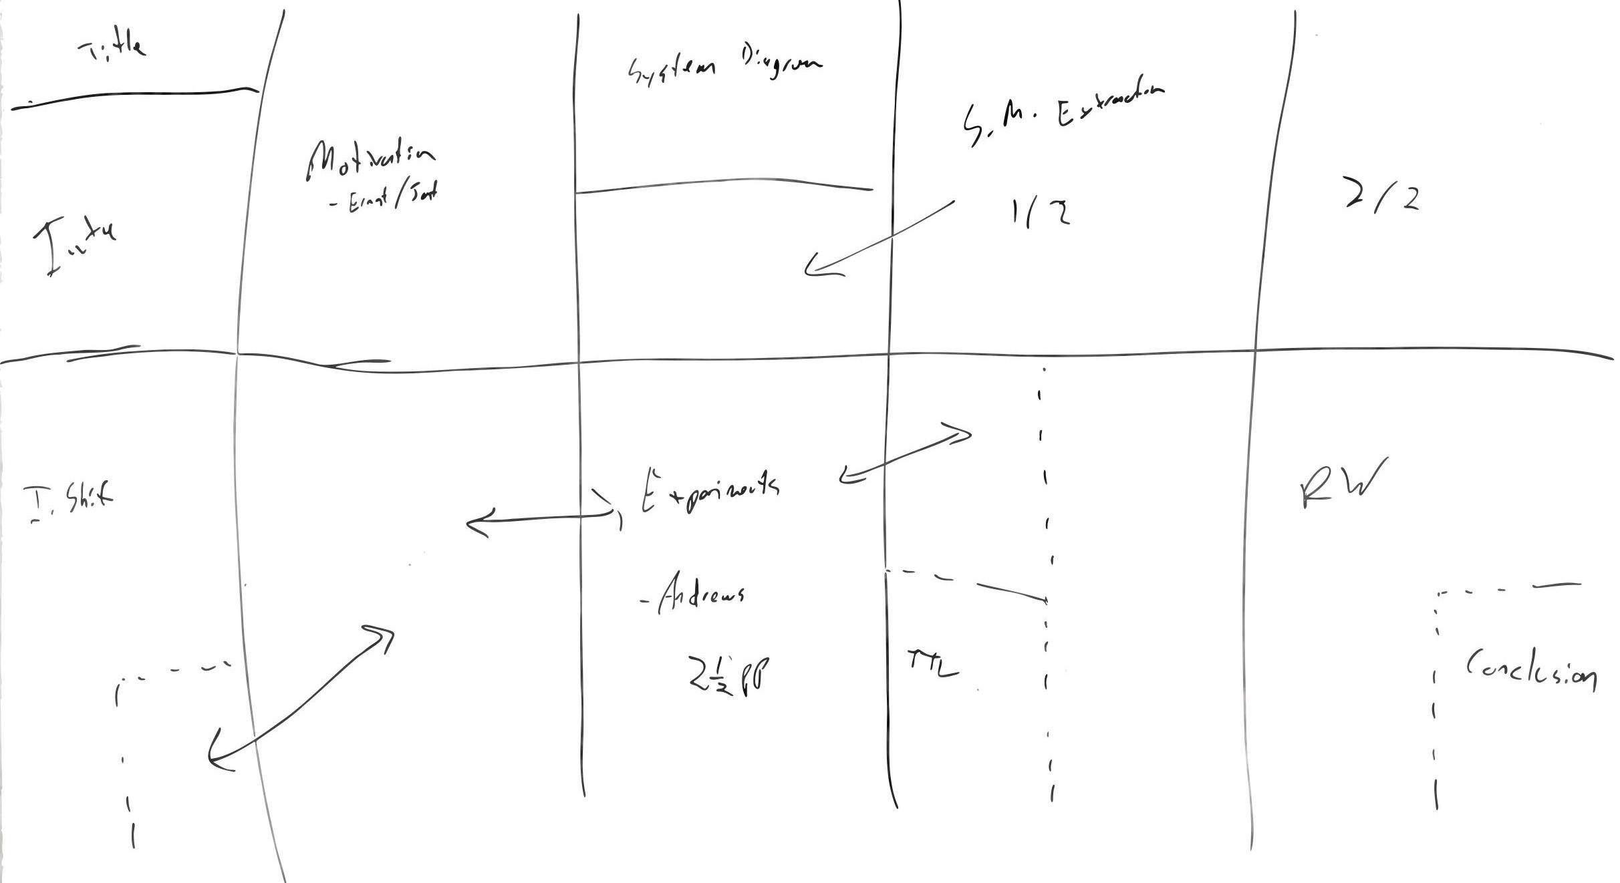
Storyboarding: Plan How to Use the Allowed Space

Slide 58
Adopt a Differential Perspective (when appropriate)
Challenge: need to overcome reviewers’ bias to think “This work is just a minor increment on XXX.”
Introduction
Sometimes the best way to introduce your idea might be to contrast it with some well-known concept
Want to ensure that the reviewer does not dismiss your idea as “It’s just the same as something I already know about.”
Overview & Core Algorithm/Idea (next slide)
Related Work
“Complimentary + complementary”

Slide 59
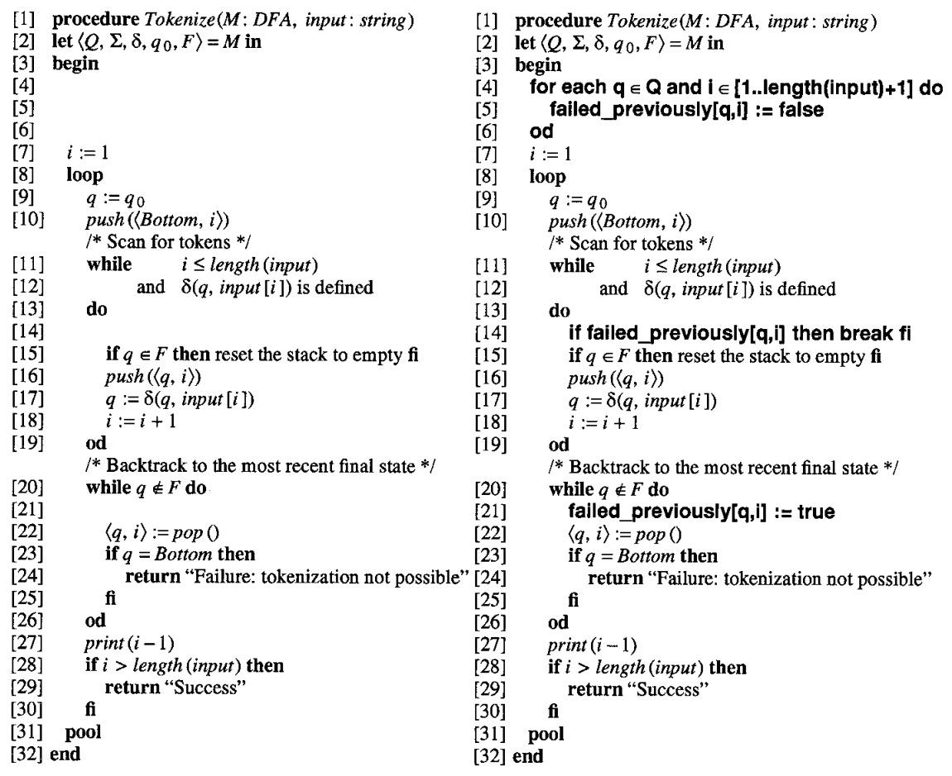
Adopt a Differential Perspective (when appropriate)
Sometimes it is the best way to explain an idea

Slide 60

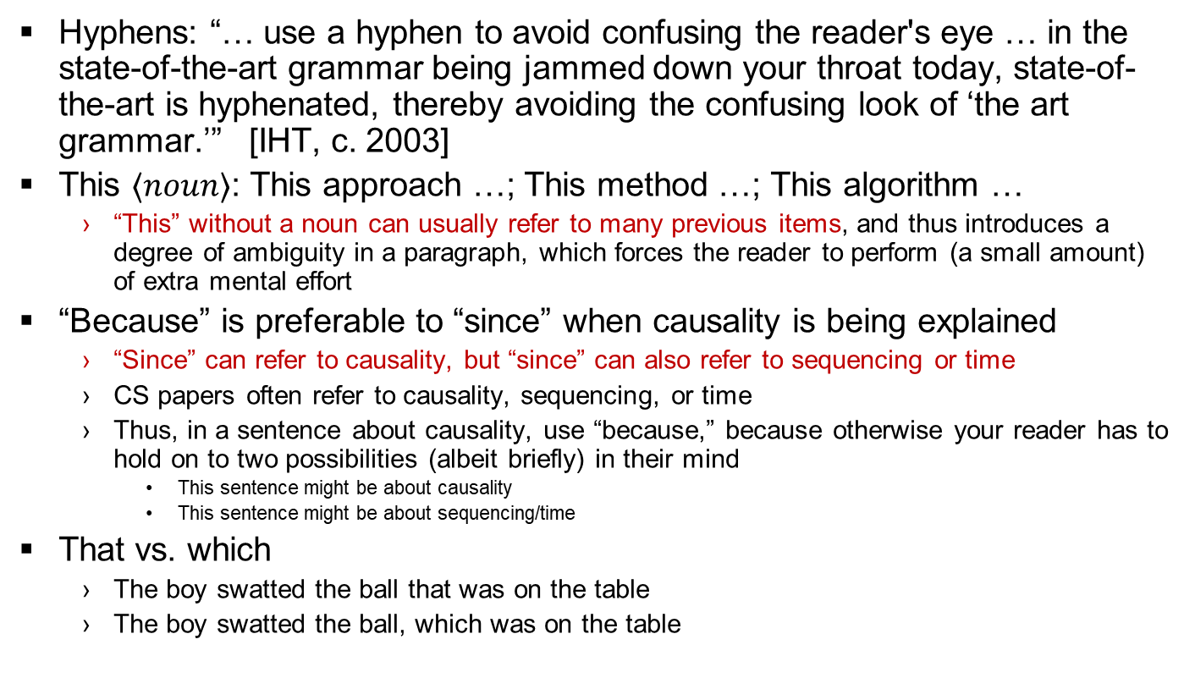
Some Language Bugaboos
Hyphens: “… use a hyphen to avoid confusing the reader's eye … in the state-of-the-art grammar being jammed down your throat today, state-of-the-art is hyphenated, thereby avoiding the confusing look of ‘the art grammar.’” [IHT, c. 2003]
This $⟨noun⟩$: This approach …; This method …; This algorithm …
“This” without a noun can usually refer to many previous items, and thus introduces a degree of ambiguity in a paragraph, which forces the reader to perform (a small amount) of extra mental effort
“Because” is preferable to “since” when causality is being explained
“Since” can refer to causality, but “since” can also refer to sequencing or time
CS papers often refer to causality, sequencing, or time
Thus, in a sentence about causality, use “because,” because otherwise your reader has to hold on to two possibilities (albeit briefly) in their mind
This sentence might be about causality
This sentence might be about sequencing/time
That vs. which
The boy swatted the ball that was on the table
The boy swatted the ball, which was on the table
What is
shown in
this picture?
It’s a that!
Not a which
(or a witch)!

Slide 61
Cap Times Review of Chen’s Dumpling House [April 11, 2018]
“[They went from] zero to 10 dumplings in 60 seconds.
For mere mortals, the technique is impressive.
(When I tried making dumplings with my friend’s family in China, my friend looked at my dumplings and said, ‘It’s OK, everyone has their own dumpling style.’)”
Rule #1: There is no universal rule for organizing your paper

